Slide 1
MaskVision: A Novel Open EUV Semiconductor Photomask Benchmark for Anomaly Detection in Semiconductor Manufacturing

Slide 2
Index
Research Background
Motivation
Method
Result
Conclusion

Slide 3
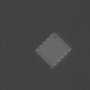
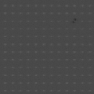
1. Research Background
“Build data and develop AI solution for pellicle/mask defect detection to improve EUV semiconductor productivity”
Semiconductor inspection often involves super high-resolution image (172,000 X 249,000 pixels) captured under high magnification.
Significant amount of images are generated from the Semiconductor image
Notes:
EUV 반도체 생산성 향상을 위한 펠리클/마스크 결함검출용 데이터 구축 및 AI 솔루션 개발

Slide 4
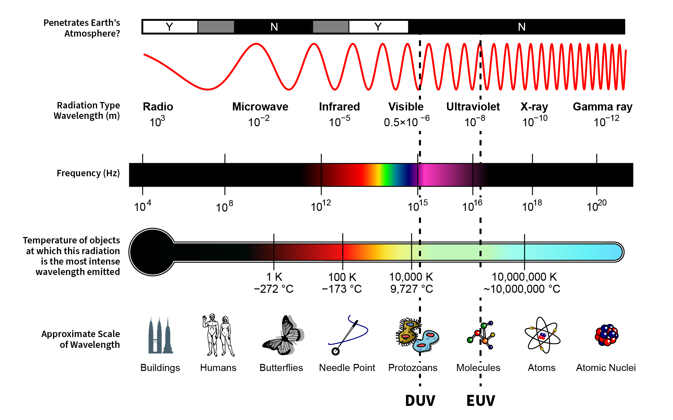
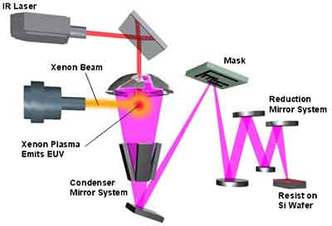
1. Research Background
Notes:
EUV 반도체 생산성 향상을 위한 펠리클/마스크 결함검출용 데이터 구축 및 AI 솔루션 개발

Slide 5
1. Research Background
Dataset | Images | Approx. Size | Domain | Typical Defects
MVTec-AD [1] | 5,000 ~ | 5 GB | 15 real-world industrial objects | Scratches, dents, missing parts, etc.
VisA [2] | 10,821 | 1.9 GB | Various small industrial items | Scratches, dents, contamination, etc.
Kolektor SDD [3] | 399 | 336 MB | Electrical commutator surfaces | Cracks in metal surfaces
Semiconductor Photomask | Approx. 2.3 Million | 39.8 GB | Semiconductor photomasks | Pattern defects, contamination
[1] Paul Bergmann, Michael Fauser, David Sattlegger, and Carsten Steger. Mvtec ad–a comprehensive real-world dataset for unsupervised anomaly detection. In Proceedings of the IEEE/CVF conference on computer vision and pattern recognition, pages 9592–9600, 2019.
[2] Yang Zou, Jongheon Jeong, Latha Pemula, Dongqing Zhang, and Onkar Dabeer. Spot-the-difference self-supervised pretraining for anomaly detection and segmentation. In European Conference on Computer Vision, pages 392–408. Springer, 2022
[3] Domen Tabernik, Samo Sela, Jure Skvarc, and Danijel Skocaj. Segmentation-Based Deep-Learning Approach for Surface-Defect Detection. Journal of Intelligent Manufacturing, 2019
Notes:
172,000×249,000 pixels

Slide 6
4. Motivation
Eliminate DNN Training
Scalable Model
Low Computational Complexity

Slide 7
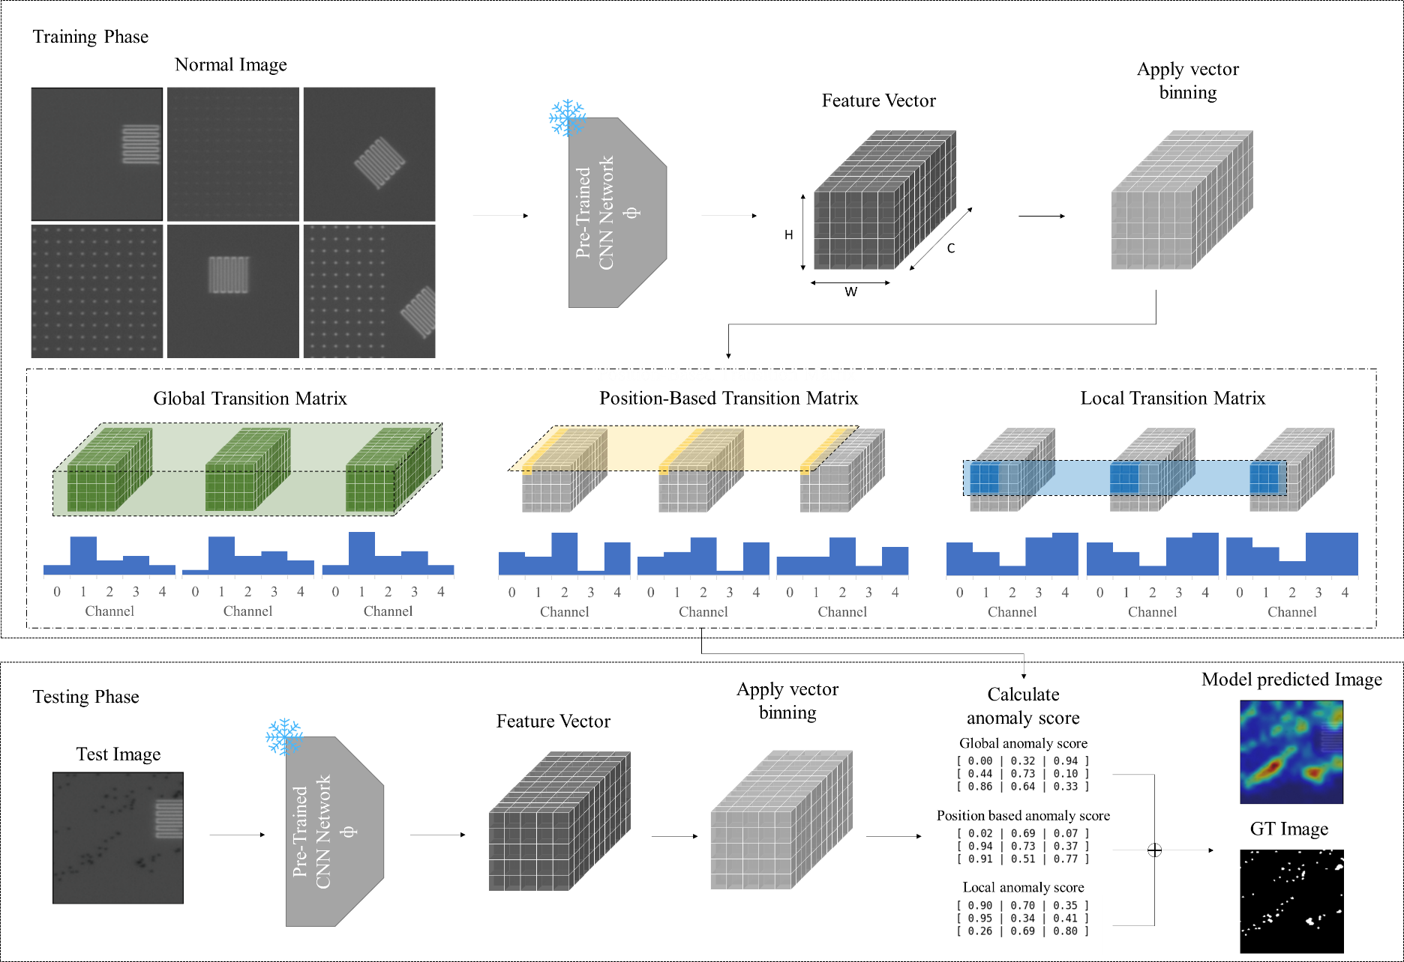
5. Method

Slide 8
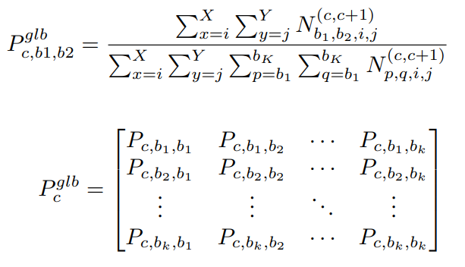
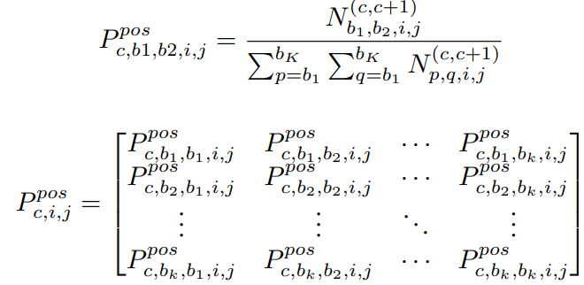
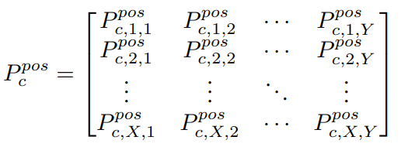
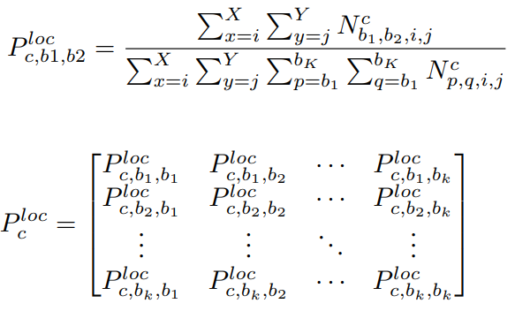
5. Method
Global Transition
Position-based transition
Local transition

Slide 9
6. Result
Photomask dataset
 | image AUROC | pixel AUROC | pixel AUPRO | Inference Speed for 100,000 images
PaDiM(*) | 0.909 | 0.98 | 0.872 | 1x
Patchcore(*) | 0.998 | 0.962 | 0.901 | 3.5714x
CFA | 0.976 | 0.984 | 0.895 | 25x
SimpleNet | 0.994 | 0.956 | 0.852 | 12.5x
Ours | 0.996 | 0.984 | 0.889 | 50x
Methods marked with (*) could not be trained on the work station due to memory overflows
Bold is the best score, and underline is second high score
Our method shows not the best scores, but it shows competitive scores
Notes:
localization accuracy 낮다
Roc 곡선: FPR(False Postive Rate) 변할 때 TPR (True Positive Rate) 어떻게 변하는지 나타내는 곡선
ROCAUC: Area Under Curve로 ROC 곡선 아래의 면적을 말함

Slide 10
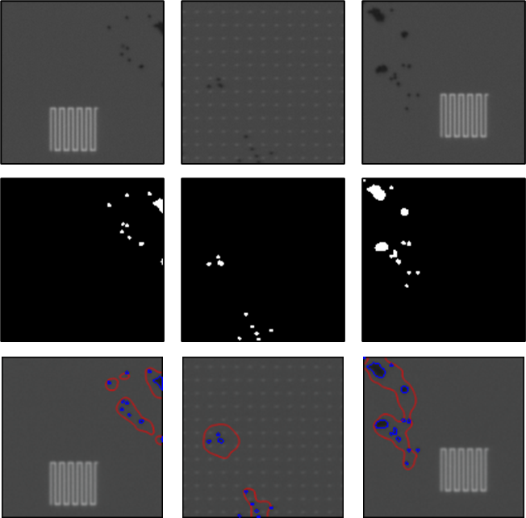
6. Result

Slide 11
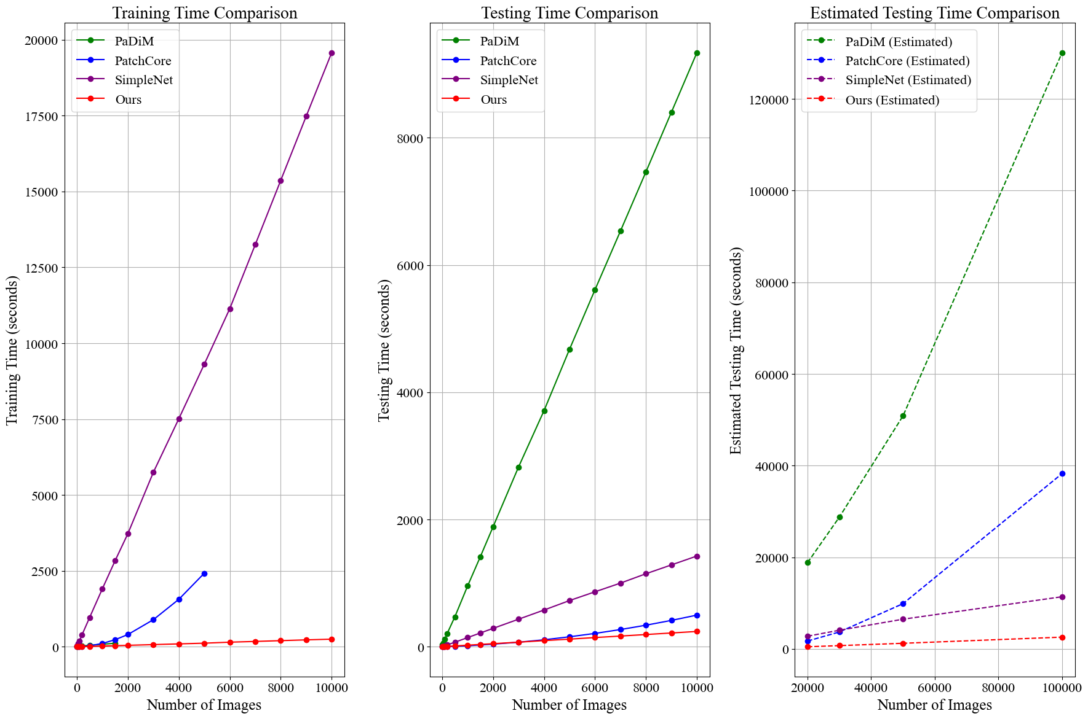
6. Result
More than
50 times
More than
14 times
More than
4 times

Slide 12
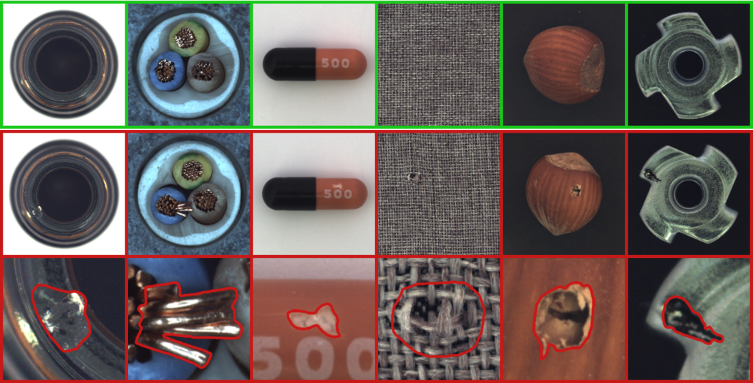
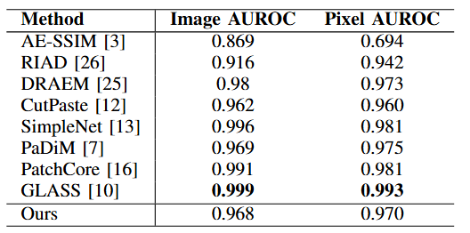
6. Result
MVTec dataset
[3] Paul Bergmann, Sindy Lowe, Michael Fauser, David Sattlegger, and Carsten Steger. Improving unsupervised defect segmentation by applying structural similarity to autoencoders. arXiv preprint arXiv:1807.02011, 2018
[26] Vitjan Zavrtanik, Matej Kristan, and Danijel Skocaj. Reconstruction by inpainting for visual anomaly detection. Pattern Recognition, 112:107706, 2021
[25] Vitjan Zavrtanik, Matej Kristan, and Danijel Skocaj. Draem-a discriminatively trained reconstruction embedding for surface anomaly detection. In Proceedings of the IEEE/CVF international conference on computer vision, pages 8330–8339, 2021
[12] Chun-Liang Li, Kihyuk Sohn, Jinsung Yoon, and Tomas Pfister. Cutpaste: Self-supervised learning for anomaly detection and localization. In Proceedings of the IEEE/CVF conference on computer vision and pattern recognition, pages 9664–9674, 2021
[11] Sungwook Lee, Seunghyun Lee, and Byung Cheol Song. Cfa: Coupled-hypersphere-based feature adaptation for target-oriented anomaly localization. IEEE Access, 10:78446–78454, 2022

Slide 13
7. Conclusion
New dataset for anomaly detection of semiconductor manufacturing
New framework for anomaly detection without relying on training deep networks
It shows both the strengths and the limitations of other models, especially regarding memory and computational cost on large data
But ours method have trade-off in accuracy

Slide 14
Thank You!

